Slide 1
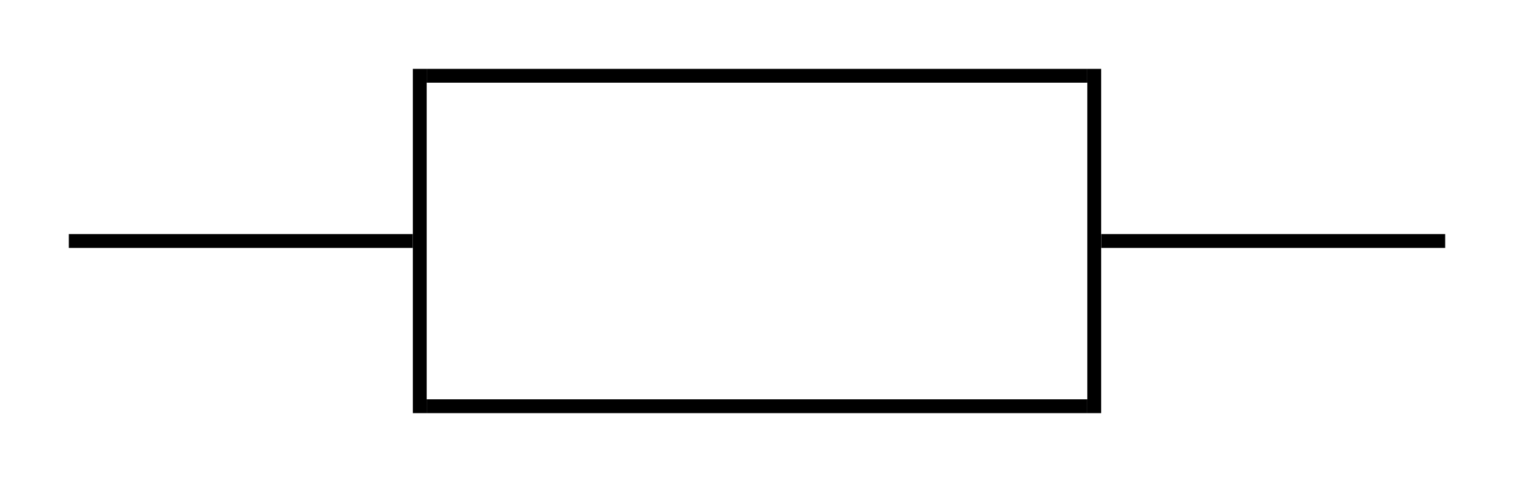

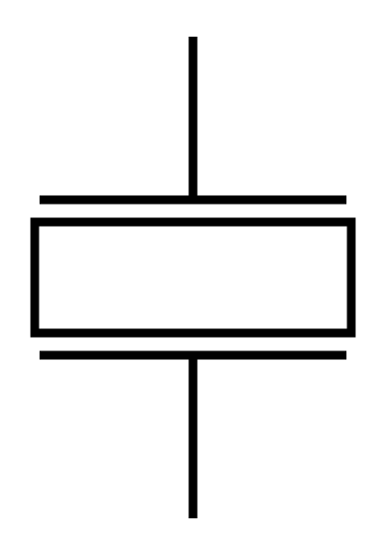

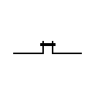
CAN Module
V1.1
13/01/2019
ARZ
5V
1 18
2 17
3 16
4 15
5 MCP2515 14
6 13
7 12
8 11
9 10
10K
CS
MISO
MOSI
SCK
Vers Arduino Nano
27pF
8MHz
27pF
1 8
2 7
3 MCP2551 6
4 5
10K
CAN High
CAN Low
5V
120K
Jumper de terminaison du CAN

Slide 2
Arduino Nano Module
V1.0
ARZ

